Slide 1
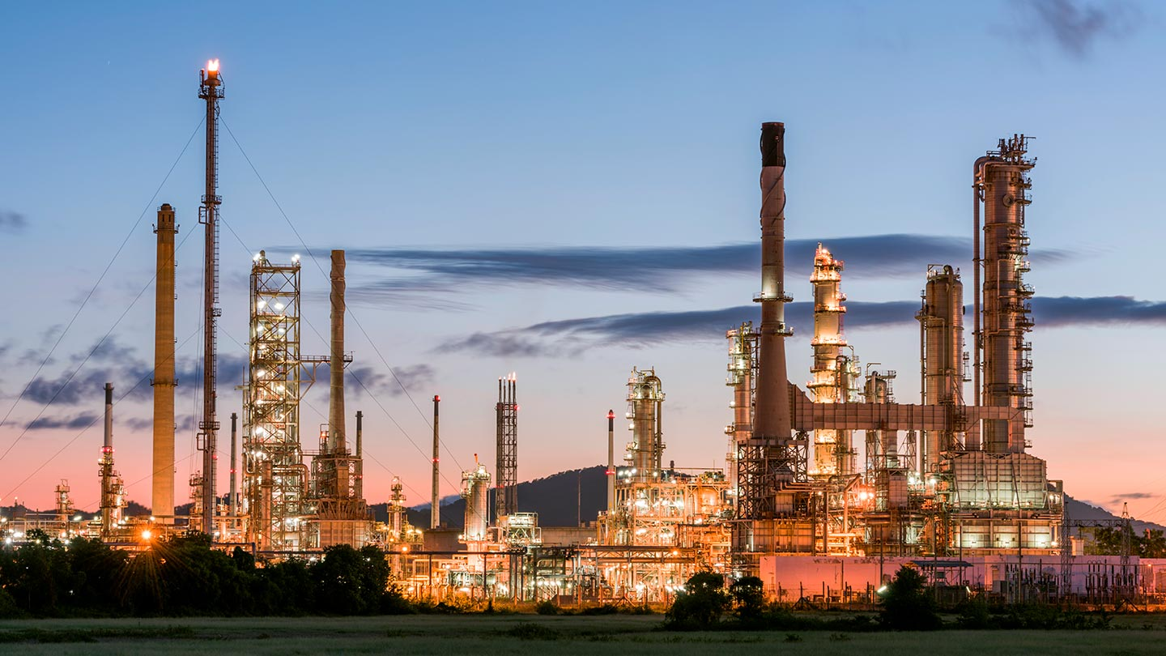
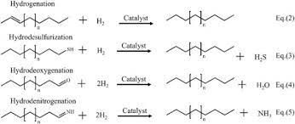
Webinar on
Catalyst Regeneration : The art of circularity & sustainability
Date: 9th August 2024
Time: 1500 to 1700 hrs
Webinar Link: https://madman.webex.com/madman/j.php?MTID=m987d72f46803c7dfda9e319cc092b14a
number: 2517 208 0426
Time (IST) Program
1500-1505: Welcome address by ED-CHT
1505-1640: Presentation by Eurecat
1640-1655: Q & A Session
1655-1700: Vote of Thanks
Coordinators:
Balayogi Nathi, Joint Director, CHT; 8590785293
Amal Roy, Advisor, CHT; 9818777160

